Slide 1
UConn Library Website Update
Jean Nelson
Provost’s Library Advisory Committee
November 30, 2018

Slide 2
Agenda
How We Manage the Web
Current Project
Future Projects

Slide 3
How We Manage the Web
Senior Management – Approval of website strategy and goals.
Service Owner – Accountable for achieving the goals of the website through coordinating the Web Steering Committee and maintenance staff.
Web Steering Committee – Sets goals and gives strategic direction and resource. Membership based on expertise related to the interaction of end users and library information portals.
Senior Management
Service
Owner
Web Steering Committee
Maintenance Staff
Work Groups
Development/Technical Staff
Notes:
Formed in October, 2017 to address how we govern and manage the day-to-day needs of our web presence.
Senior Management – This is our Senior Leadership Team, and they are responsible for approving our overall strategy and goals.
Service Owner – This is me, and I am responsible for achieving the goals of the website through coordinating the Web Steering Committee and working with identified maintenance staff to ensure the day-to-day work of the site is maintained.
Web Steering Committee – Sets goals and gives strategic direction and resource for broad-based web issues. Membership determined based on expertise related to the interaction of end users and library information portals. (members next slide)

Slide 4
How We Manage the Web
Web Steering Committee Membership –
Joel Atkinson (Access Services Librarian)
Steve Batt (Data Visualization & Sciences Librarian, Hartford)
Nick Hurley (Special Collections Research Services Assistant)
Emily Ko (Communications Designer)
Rich McIntyre (Emerging Technologies Librarian, UConn Health)
Doug Neary (Applications Developer)
Jean Nelson (Head of Communications & Engagement)
Donovan Reinwald (Instructional Design & Social Sciences Librarian)
Michael Rodriguez (Licensing & Acquisitions Librarian)
Maintenance Staff – Content owners and media designer.
Development/Technical Support Staff – Applications Developer, students.
Workgroups – Formed on an ad hoc basis by the Steering Committee.
Senior Management
Service
Owner
Web Steering Committee
Maintenance Staff
Work Groups
Development/Technical Staff
Notes:
Web Steering Committee Membership –
One reason to show the list is to understand that this pulls from all over the library and across campuses. It is also a shout out for these folks who are essentially volunteering their time above and beyond their job duties.
Joel Atkinson (Access Services Librarian)
Steve Batt (Data Visualization & Sciences Librarian, Hartford)
Nick Hurley (Special Collections Research Services Assistant)
Emily Ko (Communications Designer)
Rich McIntyre (Emerging Technologies Librarian, UConn Health)
Doug Neary (Applications Developer)
Jean Nelson (Head of Communications & Engagement)
Donovan Reinwald (Instructional Design & Social Sciences Librarian)
Michael Rodriguez (Licensing & Acquisitions Librarian)
Web Maintenance Staff – Disbursed management of content owners across the Library and media designer.
Web Development/Technical Support Staff – Currently Doug as our sole Applications Developer and a student.
Workgroups – as needed for limited projects.

Slide 5
Current Project – Front Page Modifications/Information Architecture
Goals
Make find easier!
Define important and high-traffic services/resources and increase their visibility.
Increase administrative flexibility.
Define an iterative process.

Slide 6
Current Project – Front Page Modifications/Information Architecture
Process (May-January)
Workgroups
Search box
Information architecture
Front page
Card Sorting
Library staff (15)
Best Practices
University of Michigan Student project
Review of peers and aspirants
Usability Testing
3 campuses (Stamford, Storrs, Waterbury)
46 tests – 30 undergraduates, 6 graduates, 10 faculty
Notes:
Workgroups included WSC members and staff
Card sorting was all staff
University of Michigan Library Sciences Program did a usability testing on our site in early 2018 and we utilized their results and their testing mechanisms for ours

Slide 7
Current Project – Front Page Modifications/Information Architecture
Results (May-January)
Committee learned A LOT!
Changes to
Search Box (main and secondary pages)
Navigation
Front Page
Notes:
We are still knee-deep in making changes based on all of the feedback we have gotten. So what you will see are things still in progress. We have identified our launch date for January 2.
While the visible changes on the pages are not dramatic, they are small changes that we believe won’t overwhelm the user but make an impact on making finding things easier.
Also, there has been a significant amount of back-end work that has been very valuable for those of us working in the site.
The navigation changes came with a full restructure of our content through information architecture changes
Working with ITS on a beta site
What is involved with the back end of the site (including limitations)
Usability Testing (process as well as information gathered for further study)

Slide 8
Current Project – Front Page Modifications/Information Architecture
Search Feature
Old
New
Notes:
Highlights
Search box remains at the top for easy access but expanded to:
remove dropdown options in favor of visible tabs
include an advanced search option at the start
updated help text within the search box to be more descriptive
clarified the search activation button

Slide 9
Current Project – Front Page Modifications/Information Architecture
Search Feature
Old
New
Notes:
Highlights
Secondary page search box has a sleek, clean design
Arrow will allow for it to open up to full search box mirroring what you find on the main page

Slide 10
Current Project – Front Page Modifications/Information Architecture
Navigation
Old
New
Notes:
Highlights
Simplified the options (research & services)
Removed icons to clean up the space
Added About
Libraries became locations

Slide 11
Current Project – Front Page Modifications/Information Architecture
Navigation
Notes:
Highlights
Added CTDA
Will be removing A-Z and Sitemap and adding to footer

Slide 12
Current Project – Front Page Modifications/Information Architecture
Navigation
Notes:
Highlights
Anticipating future changes to the research support changes
Added Greenhouse Studios, Scholarly Communications and Research Guides
Moved Research Now! From old Teaching & Learning

Slide 13
Current Project – Front Page Modifications/Information Architecture
Navigation
Notes:
Highlights
Grouped the services together
Will be alphabetical
Group Study Rooms being removed

Slide 14
Current Project – Front Page Modifications/Information Architecture
Navigation
Notes:
Highlights
Items from the footer were moved up (employment opportunities, start guides, staff directory, policies)
Will be removing About

Slide 15
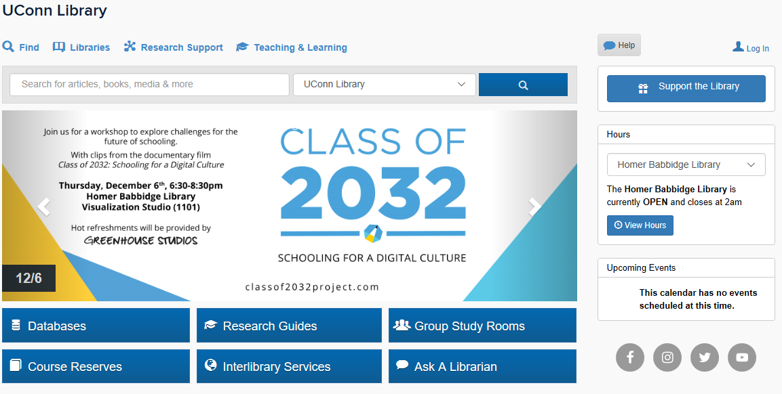
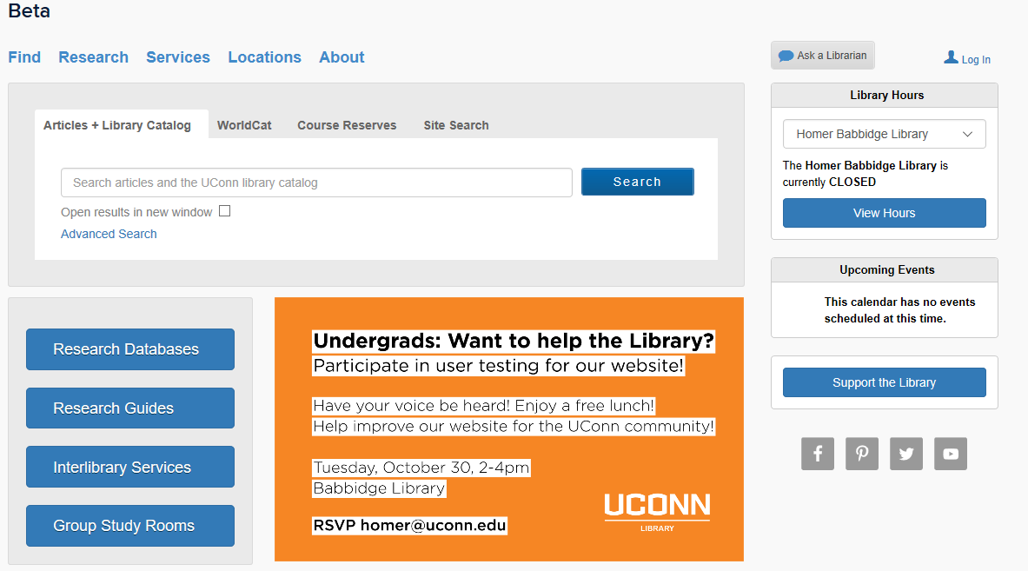
Current Project – Front Page Modifications/Information Architecture
Front Page
Notes:
Highlights
Prominent search box
Minimized the marketing materials
Eliminated some buttons and moved Ask a Librarian near where help typically goes
Modified the widgets on the right (hours, events) to make them more consistent in design
Made changes to the roll over features on the buttons to make them consistent
Responsive design

Slide 16
Future Projects
Incorporating Archives & Special Collections
Re-envisioning how we present our research services
Landing page for locating research databases
Notes:
Before we get into the opportunity for feedback, I’d like to let you know what is on our horizon

Slide 17
Feedback
Generally, what do you use the Library website for?
What do you expect to find on the Library’s homepage?
What are your pain points when using the Library’s website?
As a priority interest, what would PLAC like to see us focus on?
Notes:
I welcome your feedback on the design changes, but also generally your feelings about our website. In addition, I would love to hear more about why the website was ranked as the top interest for PLAC and what you’d like to see us work towards.

